Slide 1
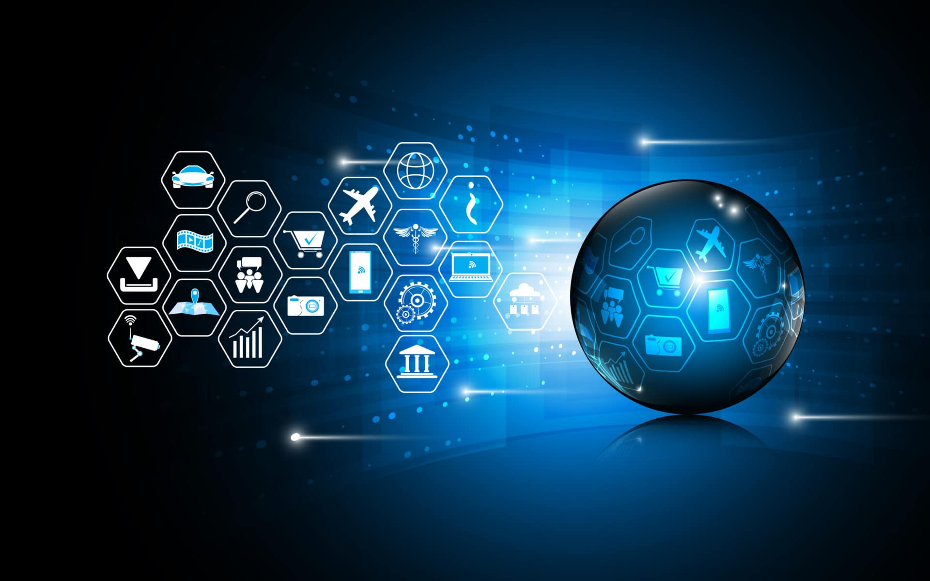
Welcome In Internet Of Things
Welcome In My Presentation
Computer Network
Presented By : Mohan Manjhi
Presented By : Mohan Manjhi

Slide 2
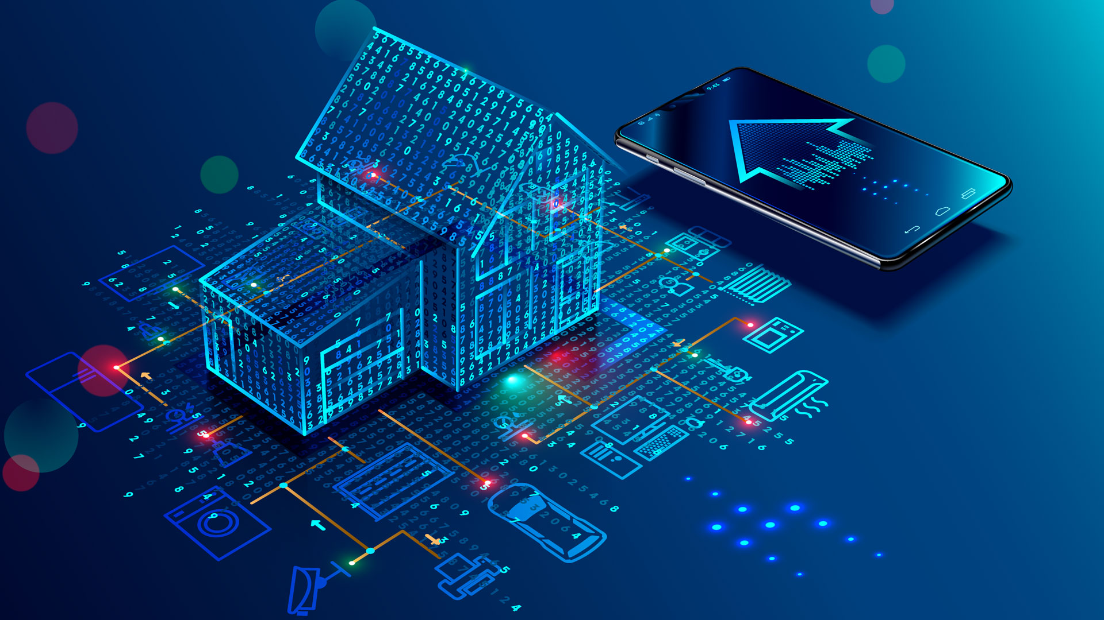
Internet Of Things

Slide 3
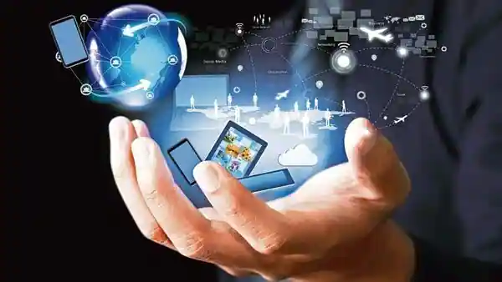
What is the Internet?
The Internet is a global network of billions of computers and other electronic devices. With the Internet, it's possible to access almost any information, communicate with anyone else in the world, and do much more.

Slide 4
01
02
What is Internet of Things?
Internet of Things Devices.
03
04
How big is the Internet of Things?
About Internet of Things security and Privacy?
05
Where does the Internet of Things go next?
IoT Style

Slide 5
What is Internet of Things?
The Internet of Things, or IOT, refers to the billions of physical devices around the world that are now connected to the internet, all collecting and sharing data. Thanks to the arrival of super-cheap computer chips and the ubiquity of wireless networks, it's possible to turn anything, from something as small as a pill to something as big as an aeroplane, into a part of the IoT. Connecting up all these different objects and adding sensors to them adds a level of digital intelligence to devices that would be otherwise dumb, enabling them to communicate real-time data without involving a human being. The Internet of Things is making the fabric of the world around us more smarter and more responsive, merging the digital and physical universes.

Slide 6
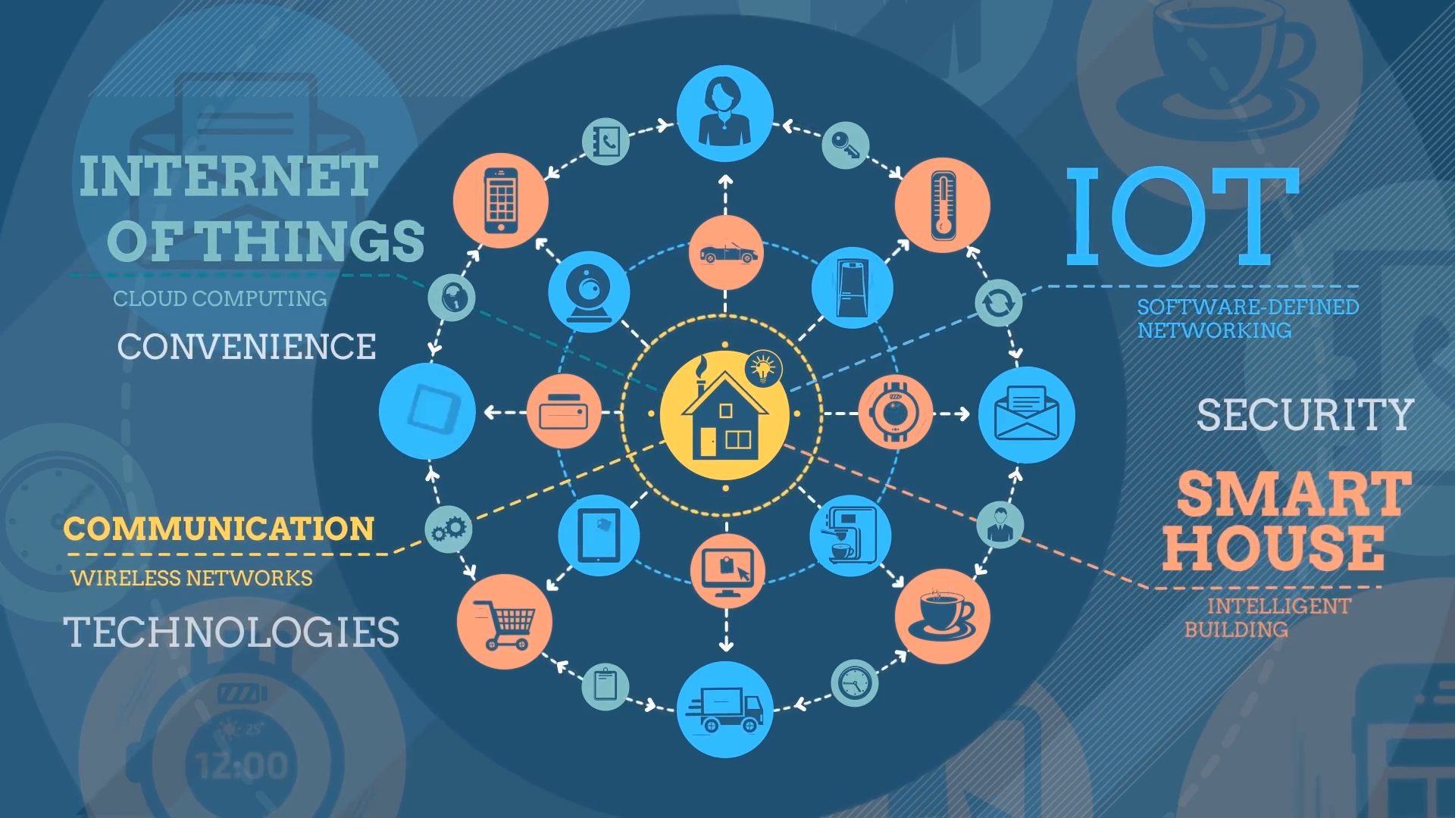

Slide 7
Example of an Internet of Things Devices.
Pretty much any physical object can be transformed into an IOT device if it can be connected to the internet to be controlled or communicate information.
LIGHTBULB
A lightbulb that can be switched on using a smartphone app is an IOT device, as is a motion sensor or a connected streetlight.
CCTV CAMREA
A Cctv camera also a IOT device that connect with Internet and control via mobile, laptop, and pc and can manage from anywhere.
SMARTPHONE
A smartphone is most uses IOT device that provide many features of IOT and this feature are very useful.
Like – Measure Temp. Measure Distance, etc. with the Help of IOT.
PC/LAPTOP
Pc/Laptop are most usable IOT devices in Big Organization, offices, and companies to manage her data.

Slide 8
How Big is the IOT.
Big and getting bigger -- there are already more connected things than people in the world.
Tech analyst company IDC (International Data Corporation) predicts that in total there will be 41.6 billion connected IOT devices by 2025, or "things." It also suggests industrial and automotive equipment represent the largest opportunity of connected "things,", but it also sees strong adoption of smart home and wearable devices in the near term.
Utilities will be the highest user of IOT, thanks to the continuing rollout of smart meters. Security devices, in the form of intruder detection and web cameras will be the second biggest use of IoT devices. Building automation – like connected lighting – will be the fastest growing sector, followed by automotive (connected cars) and healthcare (monitoring of chronic conditions).

Slide 9
1. Utilities Devices
Smart meter : Smart meters have become a preferred IoT device among utilities, with 50% identifying meter data management as a key IoT programme.
Water Management : These smart water sensors track water quality, temperature, pressure, consumption, and more. These devices typically communicate directly with a water utility company, which uses software to analyze the data and then returns it to the consumer in an easy-to-understand format.
2. Security Devices
Intruder Detection : An Intrusion Detection System (IDS) is a system that monitors network traffic for suspicious activity and issues alerts when such activity is discovered.
Most Uses IOT Devices
Web Cameras : A webcam is a video camera that feeds or streams an image or video in real time to or through a computer network, such as the Internet. Webcams are typically small cameras that sit on a desk, attach to a user's monitor, or are built into the hardware. Webcam software enables users to record a video or stream the video on the Internet.

Slide 10
SECURITY
IoT security is the practice that keeps your IoT systems safe.
IoT security tools protect from threats and breaches, identify and monitor risks and can help fix vulnerabilities.
IoT security ensures the availability, integrity, and confidentiality of your IoT solution.
PRIVACY

Slide 11
Why is IoT security & privacy so important?
Hardware, software and connectivity will all need to be secure for IoT objects to work effectively. Without security for IoT, any connected object, from refrigerators to manufacturing bots, can be hacked. Once hackers gain control, they can usurp the object's functionality and steal the user's digital data.

Slide 12
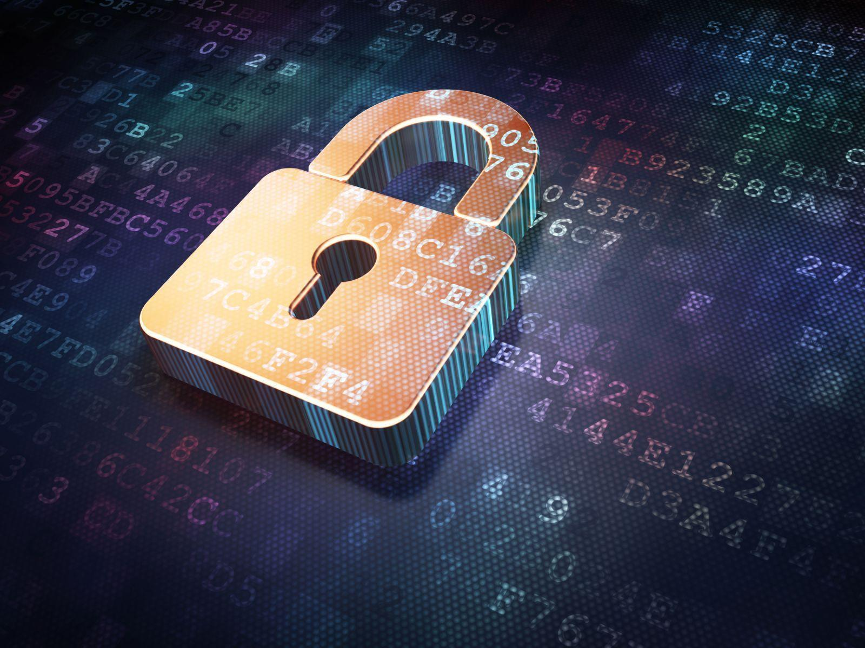
Security Risks
IoT devices are connected to your desktop or laptop. Lack of security increases the risk of your personal information leaking while the data is collected and transmitted to the IoT device.
01
.
02
IoT devices are connected with a consumer network. This network is also connected with other systems. So if the IoT device contains any security vulnerabilities, it can be harmful to the consumer’s network. This vulnerability can attack other systems and damage them.
03
Sometimes unauthorized people might exploit the security vulnerabilities to create risks to physical safety.

Slide 13
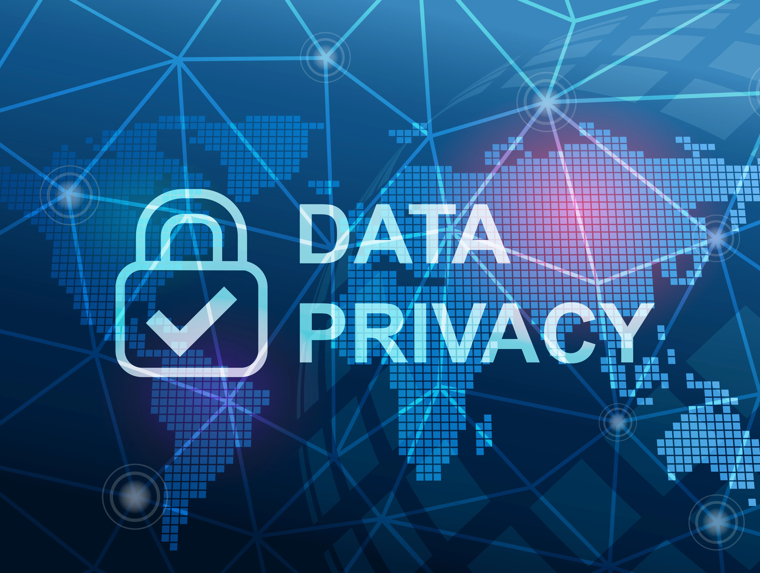
Privacy Risks
01
In IoT, devices are interconnected with various hardware and software, so there are obvious chances of sensitive information leaking through unauthorized manipulation.
.
All the devices are transmitting the user’s personal information such as name, address, date of birth, health card information, credit card detail and much more without encryption.
02

Slide 14
IoT in Present Time
No one can deny that technology has taken a quantum leap in a few short years, and it continues to develop faster than most of us can keep up with.
One of the most rapidly growing sectors of technology is the Internet of Things (IoT), where devices interact with other devices to keep people connected.
How is IoT being used today? IoT provides convenience and mobility to millions of users, but the many benefits of the Internet of Things have to be weighed against its dark side.
Twenty years ago, none of us could have imagined how technology and the Internet would transform the way we work, communicate, entertain and socialize.
It seems we time-traveled at warp speed to a new dimension where the entire world is at our fingertips.
Technology has liberated us from cubicles, snail mail, shopping malls and time zones, ushering in a new era of unprecedented connectivity.
IoT connects and integrates our software and devices, molding work processes and communication to fit the way we live in the 21st Century.
70%

Slide 15
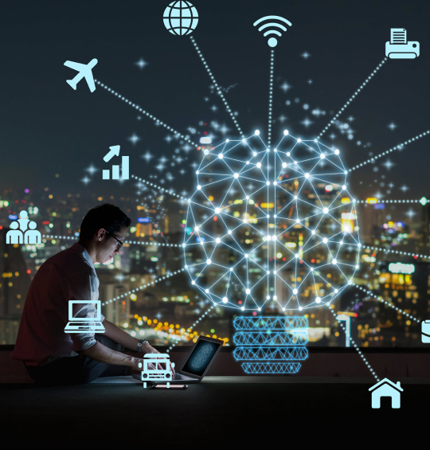
IoT Evolution – What Next?
As the price of sensors and communications continue to drop, it becomes cost-effective to add more devices to the IoT.
Deployments are at an early stage; most companies which are engaging with the IoT are at the trial stage right now, largely because the necessary technology – sensor technology, 5G and machine-learning powered analytics- are still themselves at an reasonably early stage of development.
Without standards and with security an ongoing issue we are likely to see some more big IoT security mishaps in the next few years.
As the number of connected devices continues to rise, our living and working environments will become filled with smart products, assuming we are willing to accept the security and privacy trade-offs.
Some will welcome the new era of smart things. Others will simply aren’t ready to advance to the next level of technology just yet.

Slide 16
THANK YOU
For Give Me this opportunity to Introduce myself I hope you Like My Presentation

